Slide 1



SELENIUM TESTING & DOCKER
annu_Khandelwal
By: Tannu Khandelwal
Id: 201329
Trainer: Sachin Vasav

Slide 2


AGENDA
Introduction of Selenium
Components of Selenium
Introduction of Docker
Our Project
Selenium Testing
Docker

Slide 3

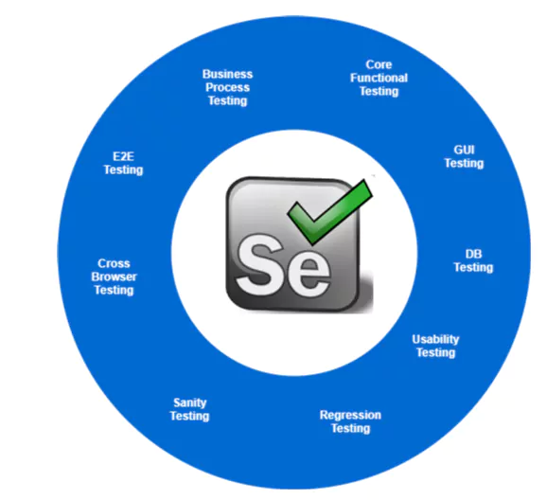
Introduction of Selenium Testing
Selenium is a free (open-source) automated testing framework.
Used to validate web applications across different browsers and platforms. Multiple programming languages like Java, C#, Python, etc to create Selenium Test Scripts.
Testing done using the Selenium testing tool is usually referred to as Selenium Testing.

Slide 4
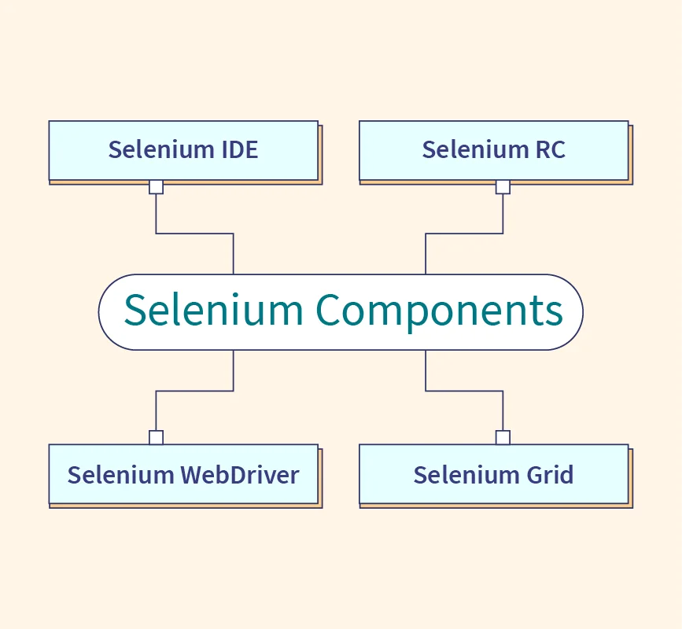
COMPONENTS OF SELENIUM
Selenium IDE(Integrated Development Environment) : allows for recording, editing and debugging of functional tests.
Selenium RC (Remote control) write automated tests for a web application in any programming language, which allows for better integration of Selenium in existing unit test frameworks.
Selenium Web Driver : accepts commands and sends them to a browser.
Selenium Grid : server that allows tests to use web browser instances running on remote machines.

Slide 5


INTRODUCTION TO DOCKER
Docker is a set of platforms as a service (PaaS) products that use the Operating system level virtualization to deliver software in packages called containers.
Containers are isolated from one another and bundle their own software, libraries, and configuration files.
They can communicate with each other through well-defined channels.
All containers are run by a single operating system kernel and therefore use fewer resources than a virtual machine.

Slide 6




OUR PROJECT
Creating Docker image and deploying in docker container.
Selenium Testing
Docker

Slide 7
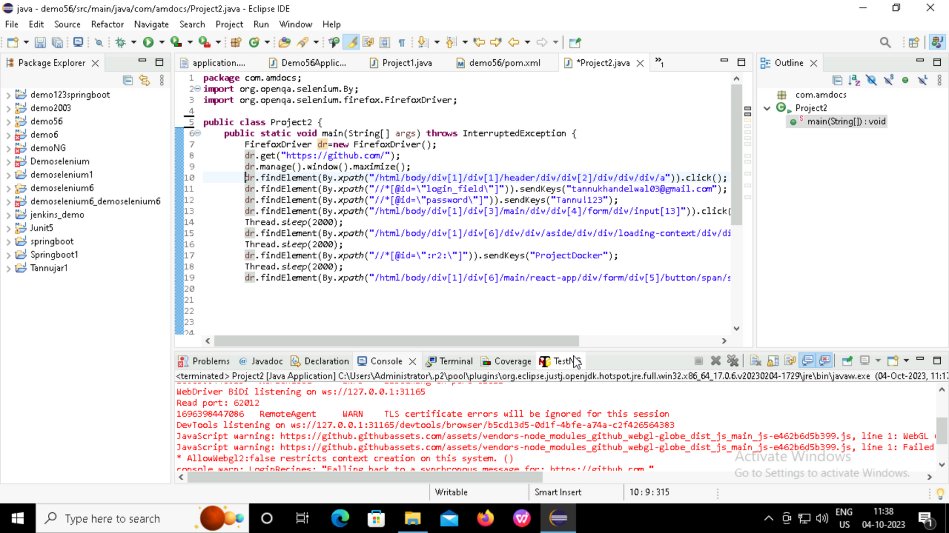
SELENIUM TESTING
Selenium Testing on GitHub site

Slide 8
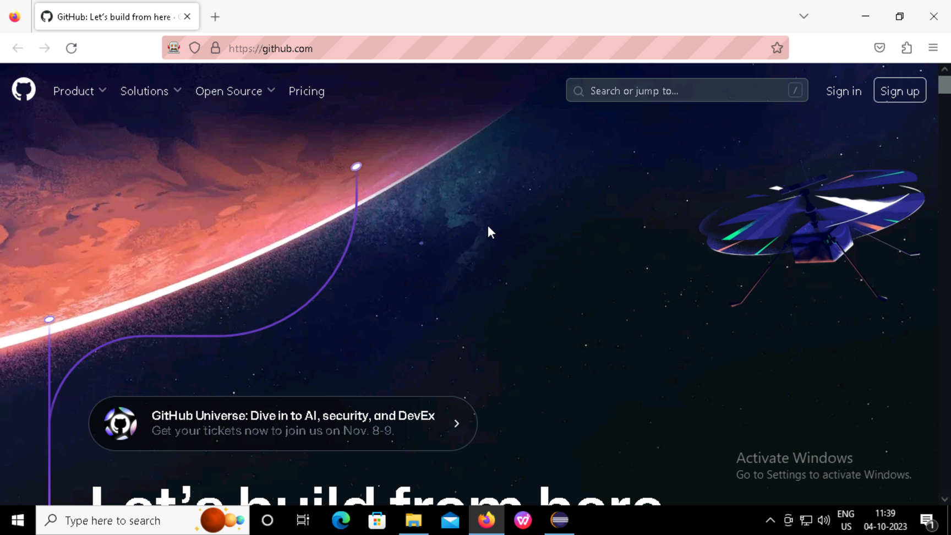
Selenium Testing on Github site Output

Slide 9
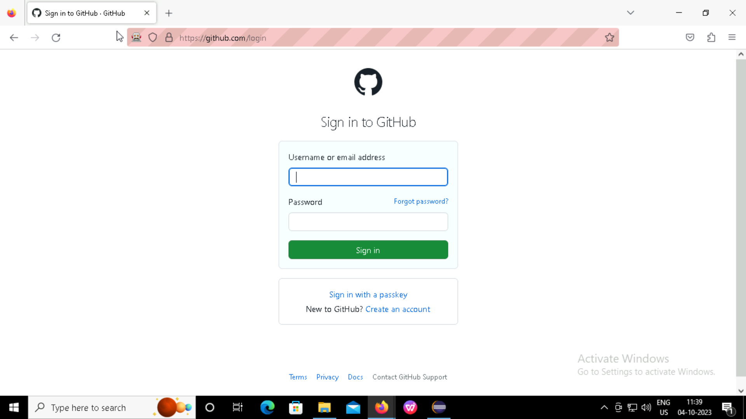
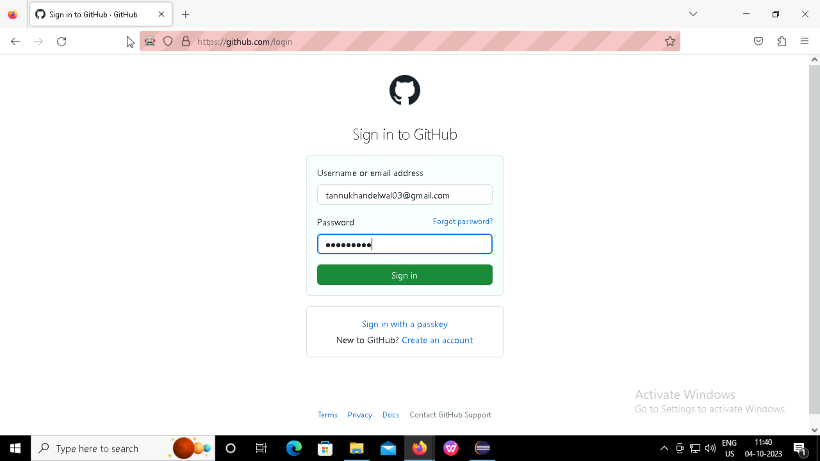
Obtaining email id as a Output
Obtaining password as a Output

Slide 10
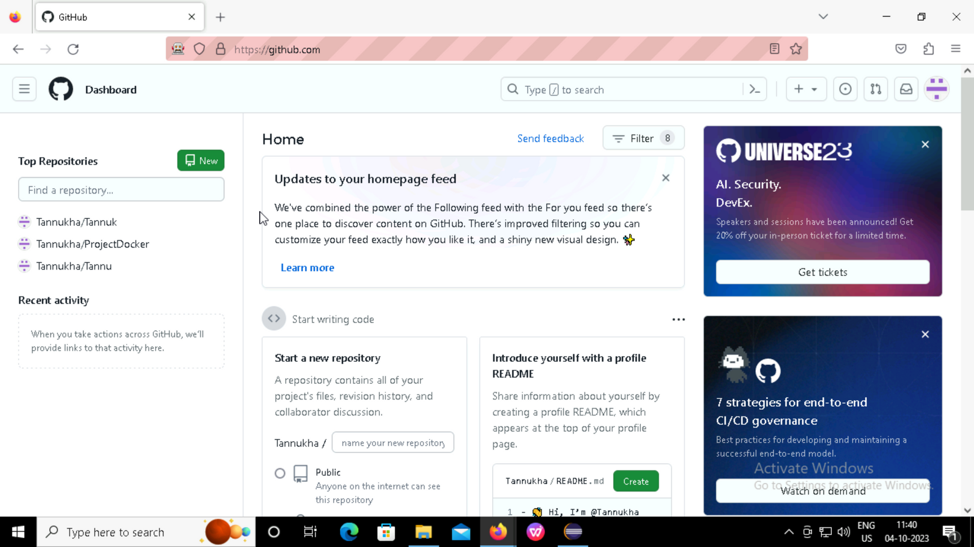
We are on Home Page

Slide 11
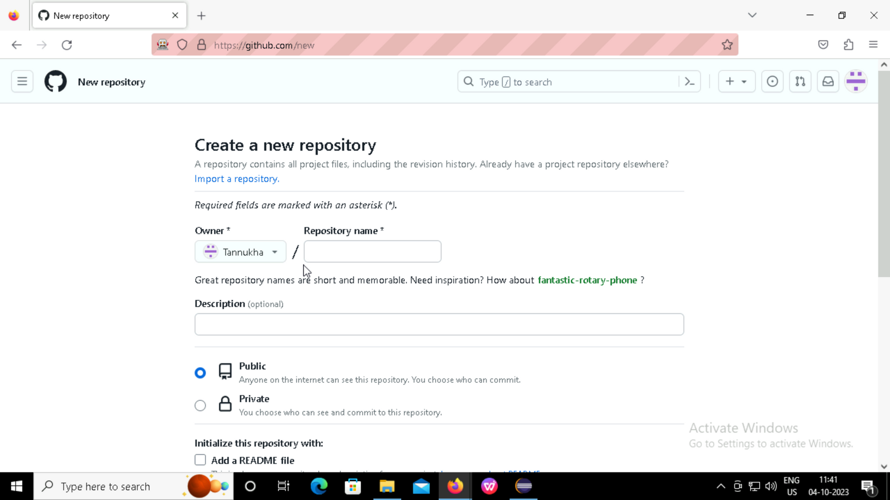
Output of Click Operation on New Repository Button

Slide 12
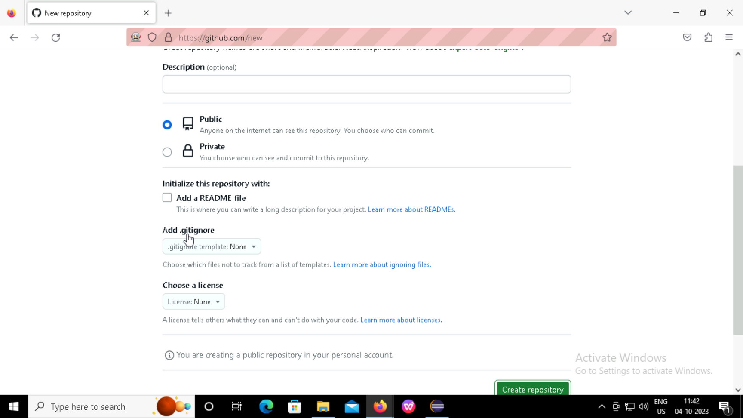
Click Operation on Create Repository Button

Slide 13
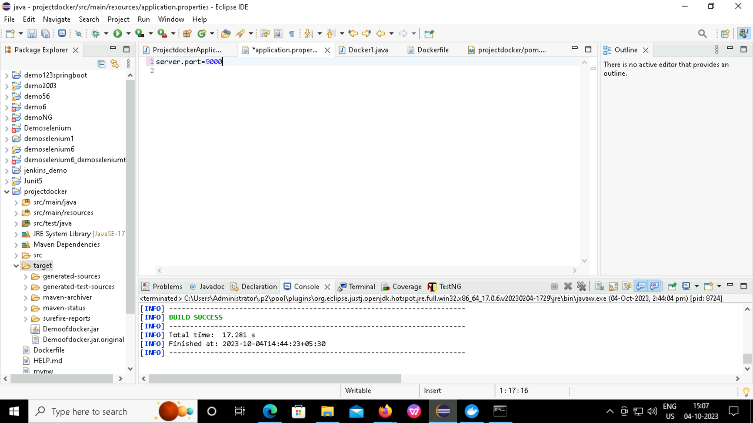
DOCKER
Code for Application properties

Slide 14
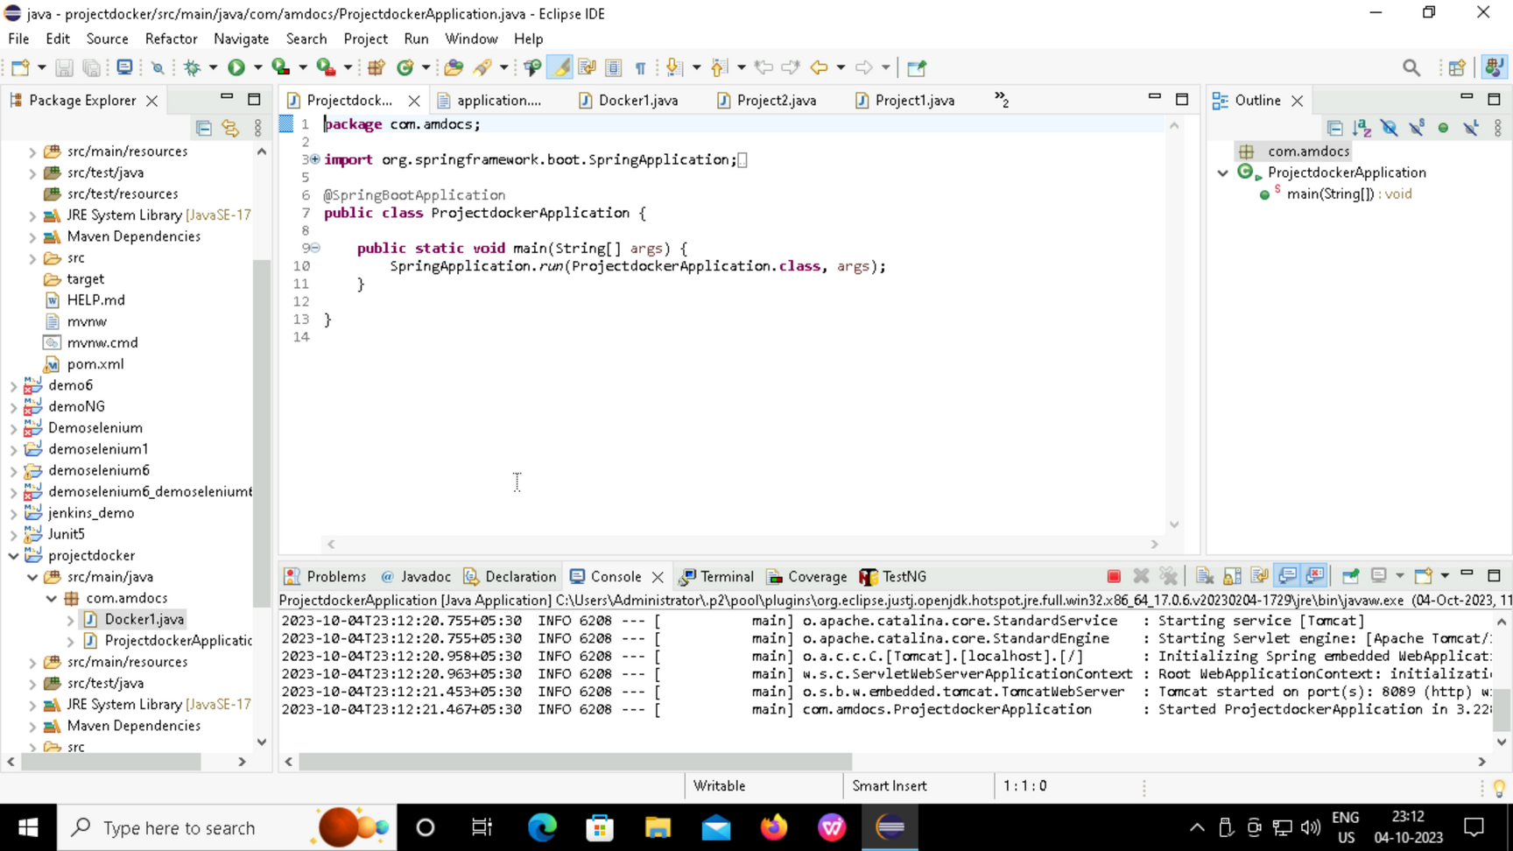
Code for Docker Application

Slide 15
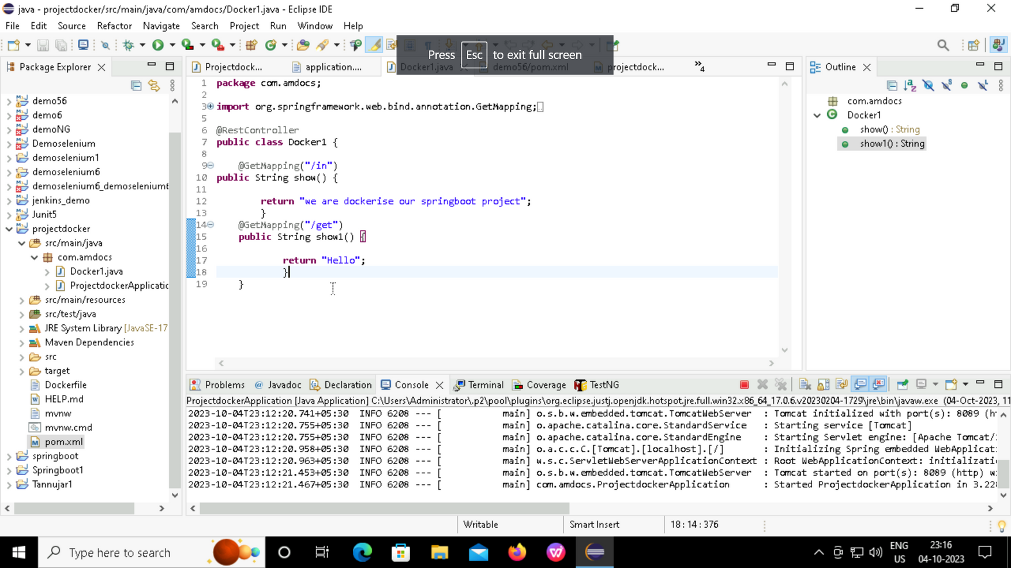
Code for Docker

Slide 16
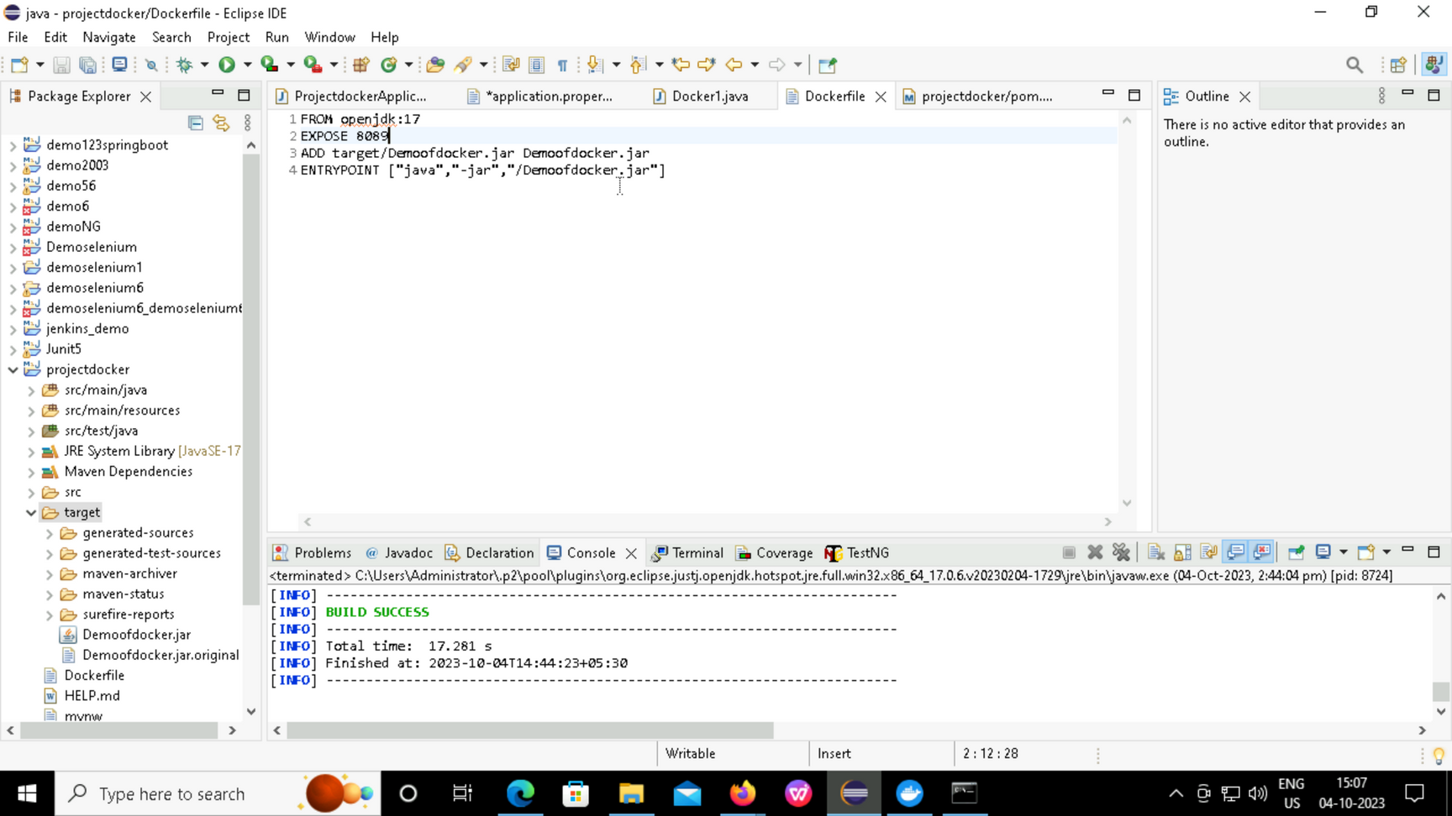
Code for Docker File

Slide 17
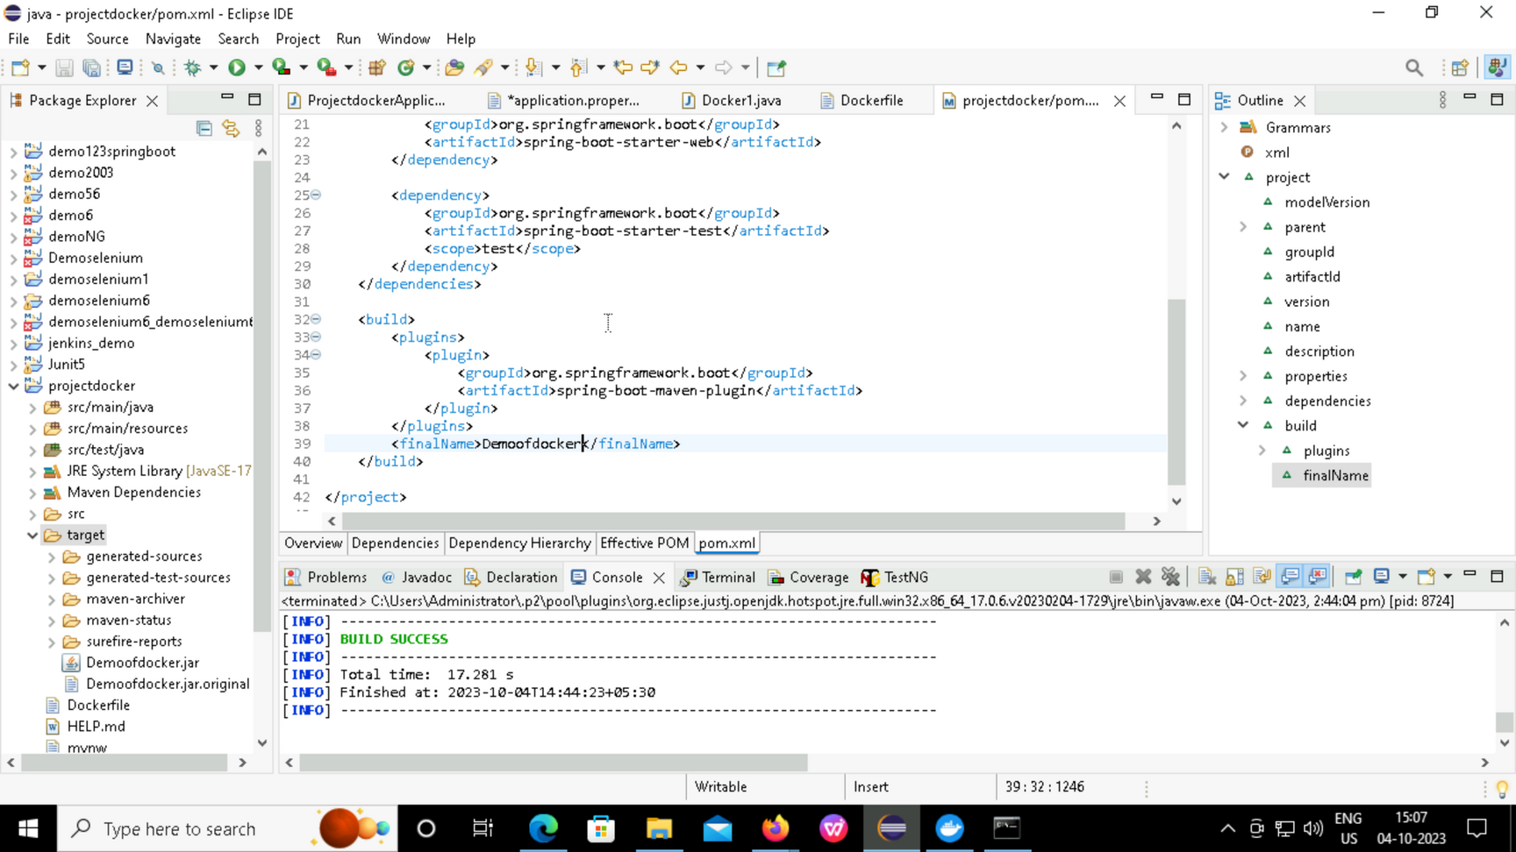
Dependencies for Pom.xml

Slide 18
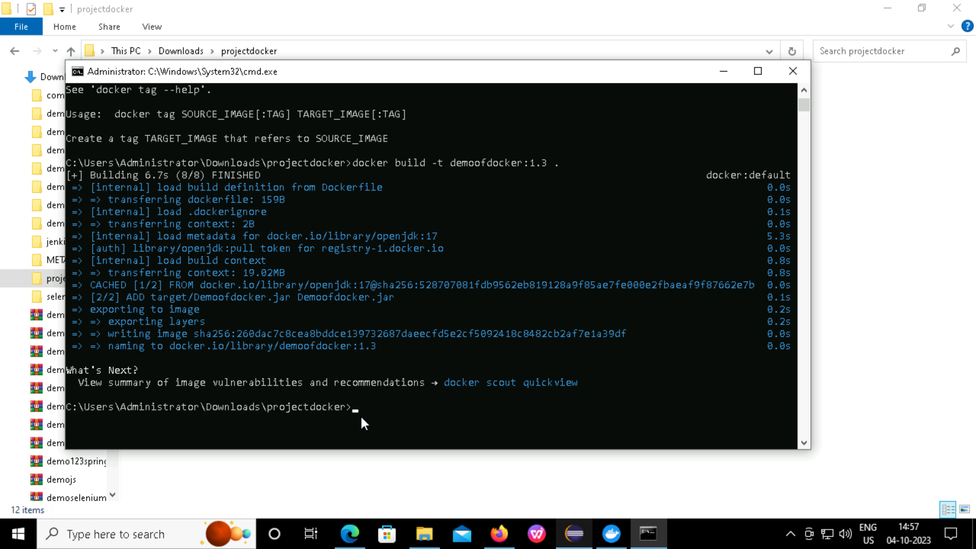

Slide 19
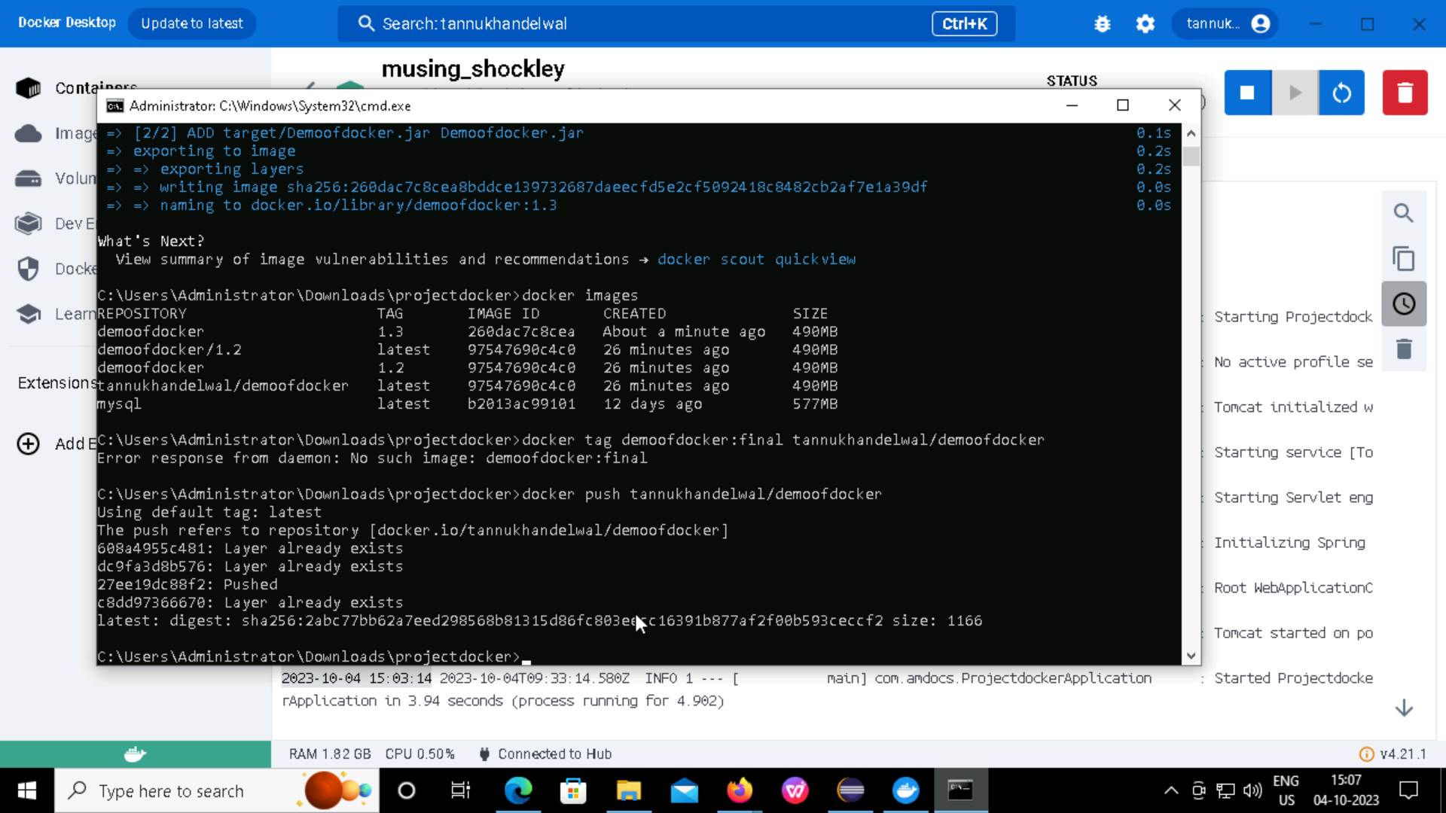

Slide 20
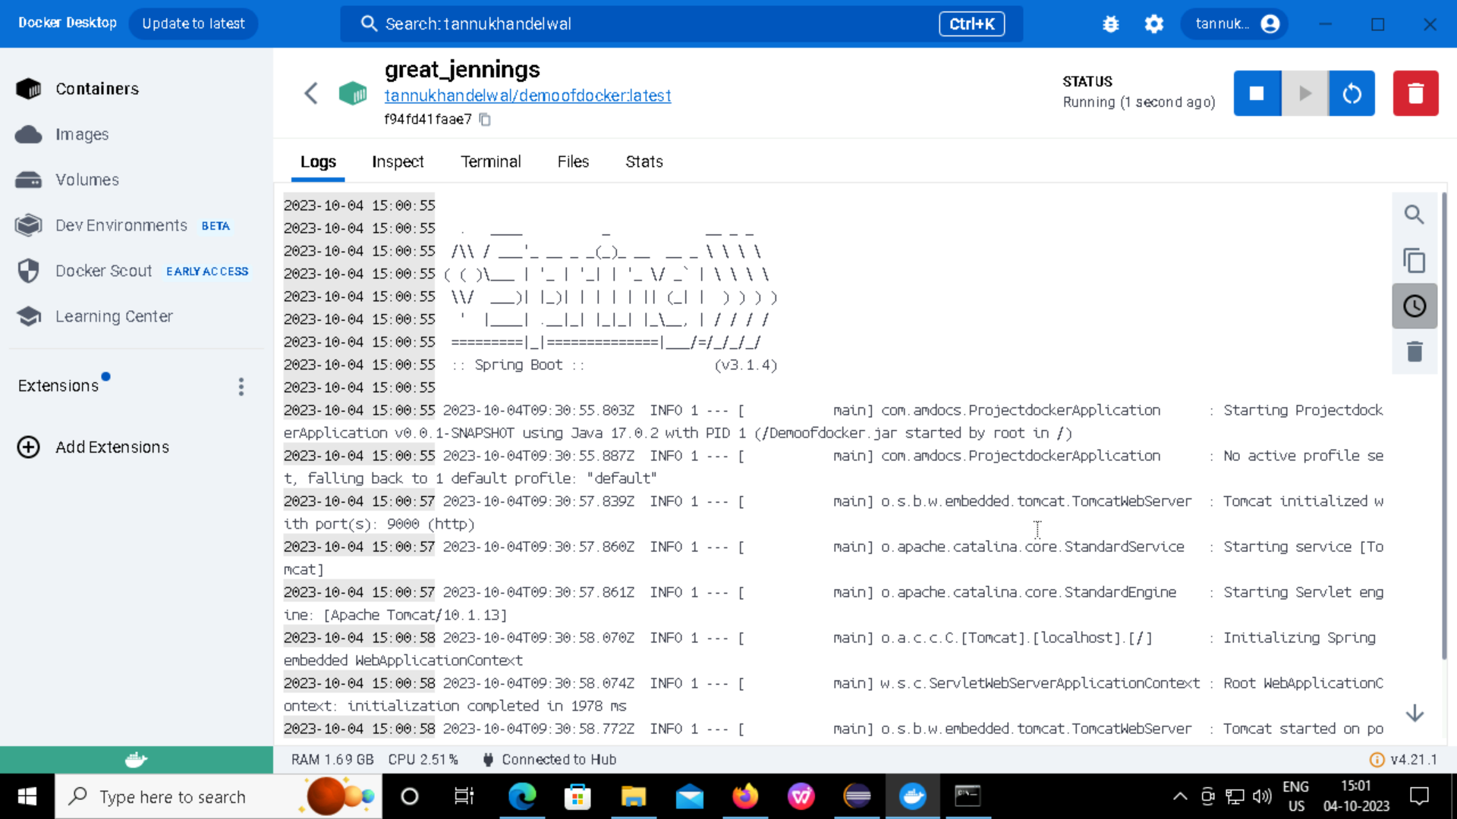
Output Screen of Docker

Slide 21
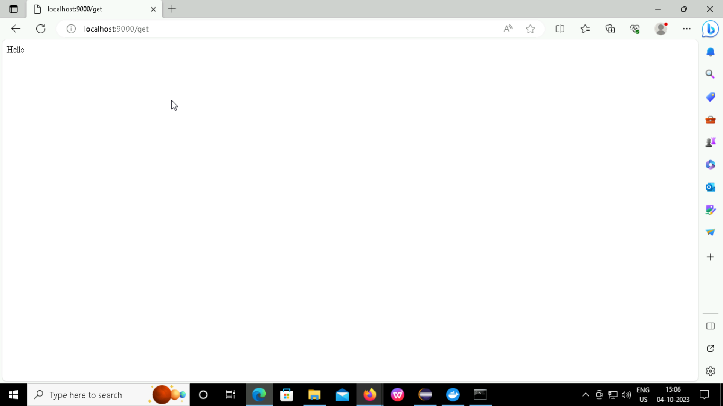
output Screen after searching on local host for get command

Slide 22


THANK
YOU
Calle Cualquiera 123, Cualquier Lugar

